Slide 1
BIOS 669: Final Project Recalled Food Products in the U.S Spring 2024 Joyce Choe

Slide 2
Data Sources
openFDA food enforcement API
Public data about recalled food products in the U.S. from 2004-present
Look-up info. on food business center regions
Key variables used for this project:
Name | Description
classification | Class I (adverse), Class II (temporarily adverse), Class III (unlikely adverse)
distribution_pattern | Places in the U.S. where recalled food product were distributed
*date1year | Year of recall initiation date
*days | Number of days between termination-initiation dates
*general_reason | general reason for recall
*message | Recall notification method
recall_initation_date | Date when recall was first notified
recall_termination_date | Date when recall investigation is done
state | state location of firm
*usda_region | Food regional business center (classified state to a usda_region)
voluntary_mandated status | Recall was voluntarily reported by firm or mandated by FDA
Source: https://open.fda.gov/apis/food/enforcement/
* = calculated or merged variable

Slide 3
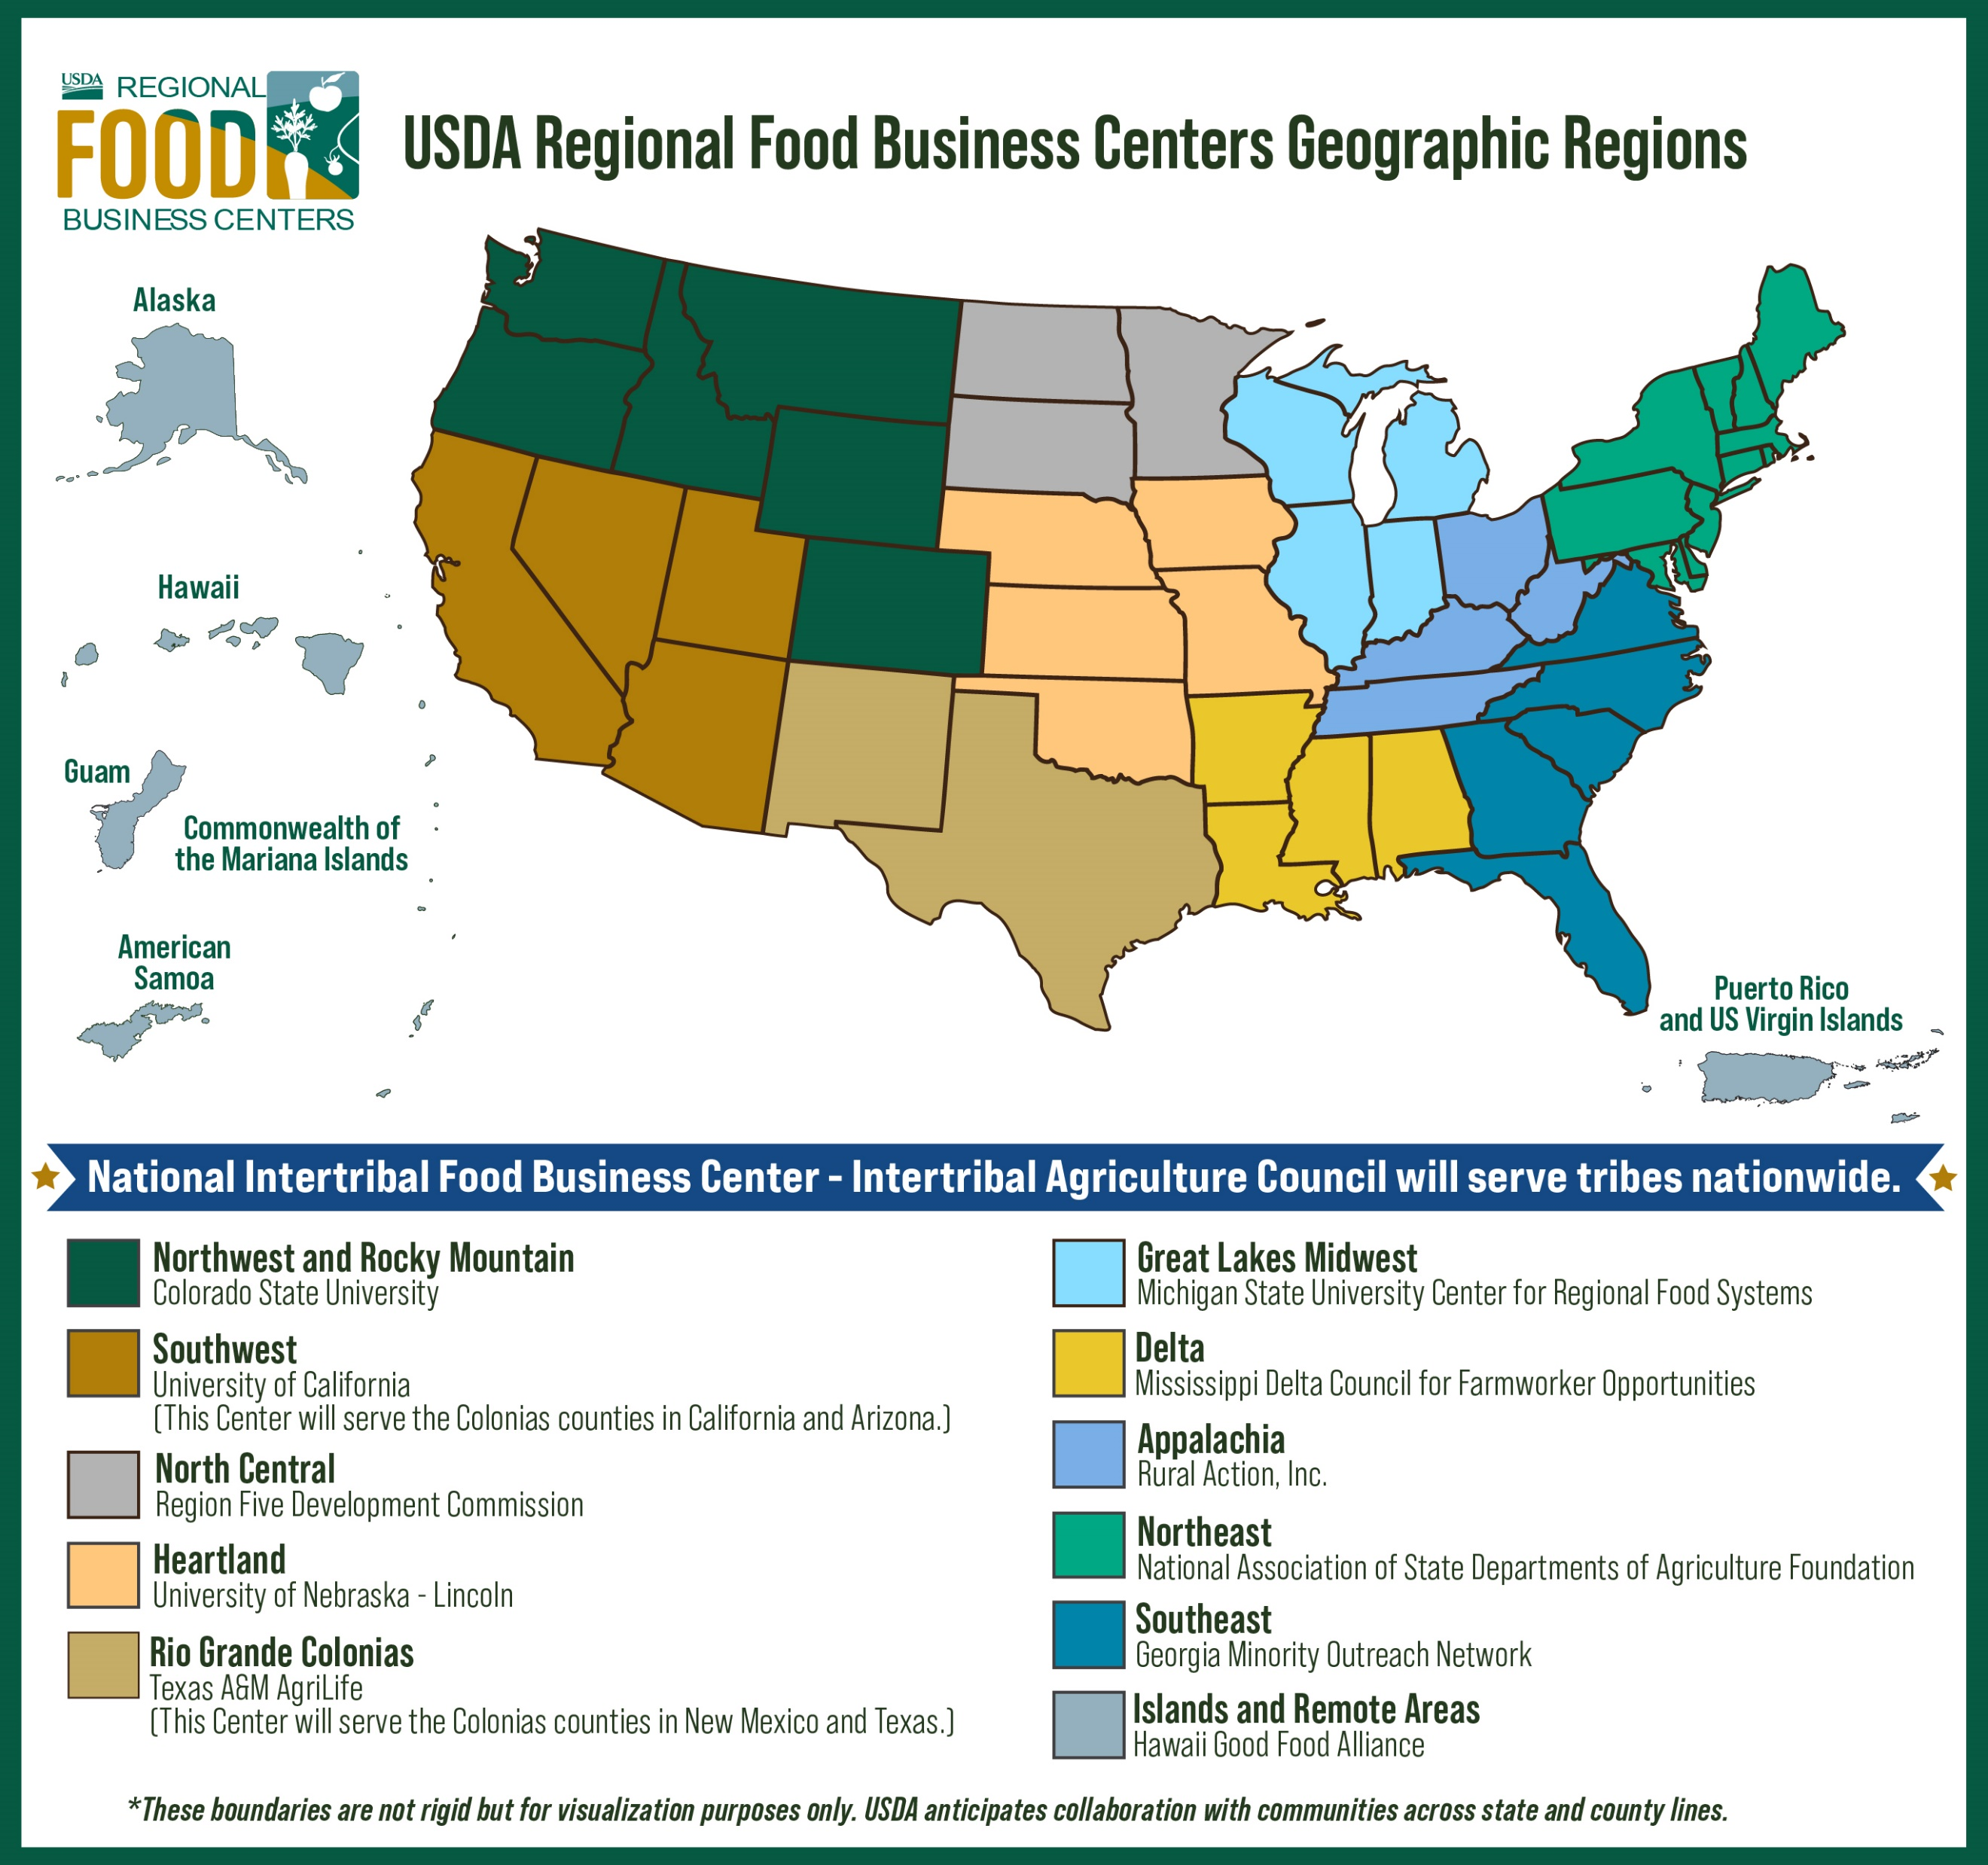
Look-up information
Modified for this project
11 regions + 1 international = 12 regions
Did not include Intertribal
Classified food firms in or outside of the U.S. to a region
Source: https://www.ams.usda.gov/services/local-regional/rfbcp

Slide 4
Data set
Subset
June 2012 - present
Terminated status (investigation done)
Distribution pattern including NC
Unique recall_id
Excluded missing values
Goal
Use final data set for exploratory data analysis (EDA), visualizing trends:
N=1890 recalled food products

Slide 5
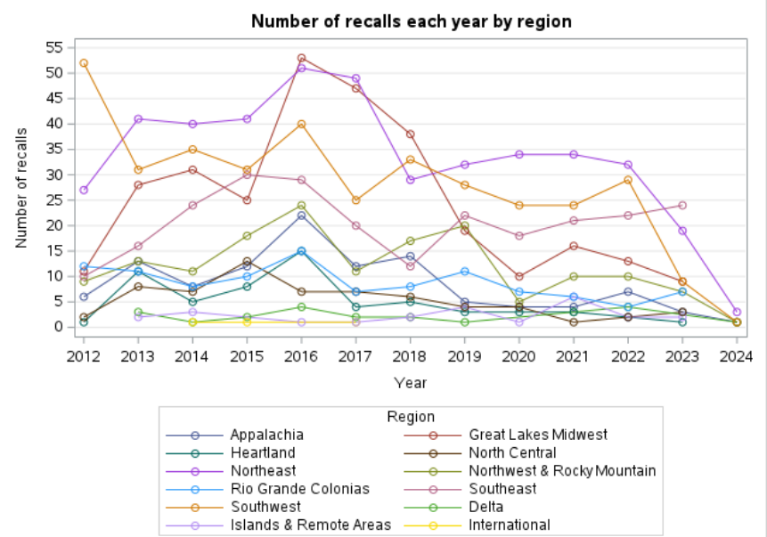
Recalls by region, year

Slide 6
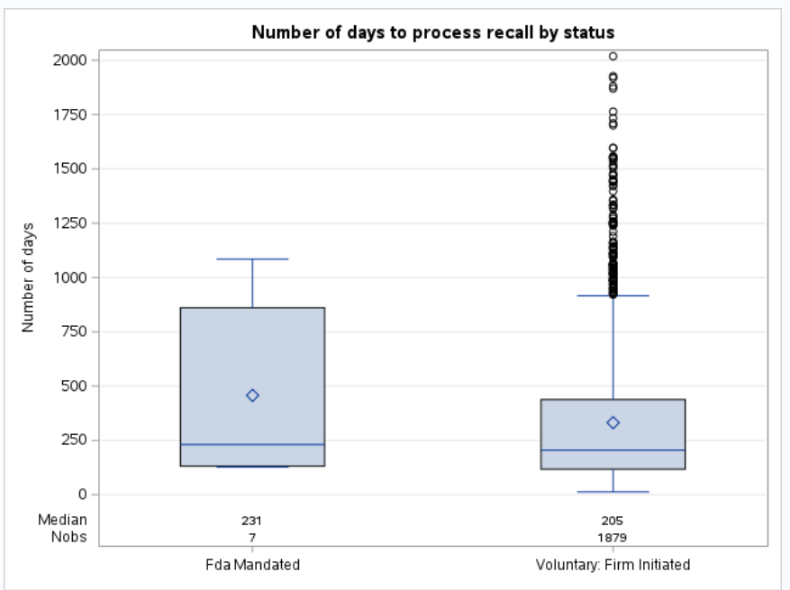
Days to process recall by status

Slide 7
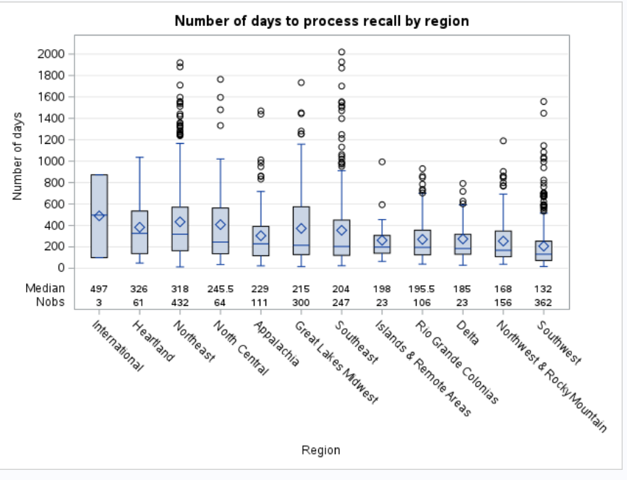
Days to process recall by region

Slide 8
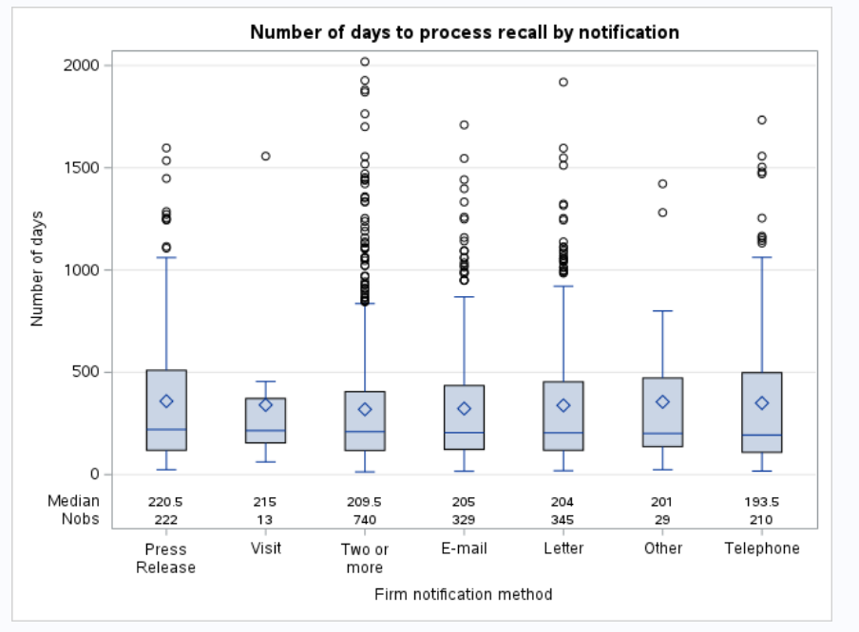
Days to process recall by notification

Slide 9
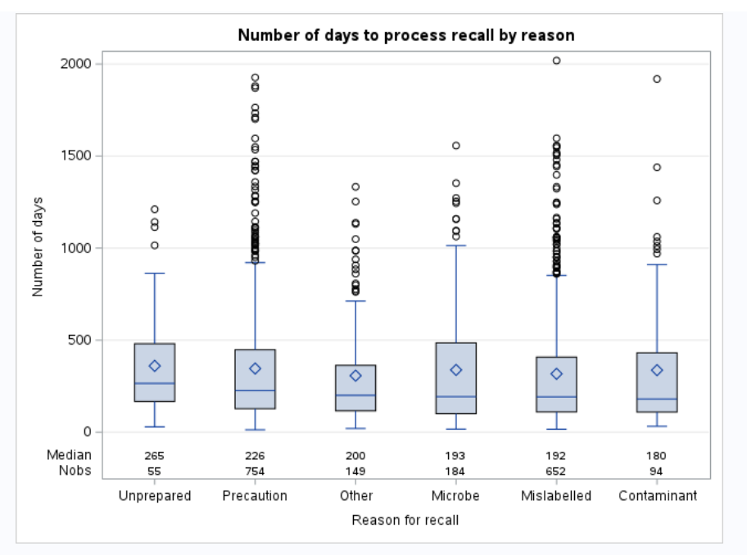
Days to process recall by reason

Slide 10
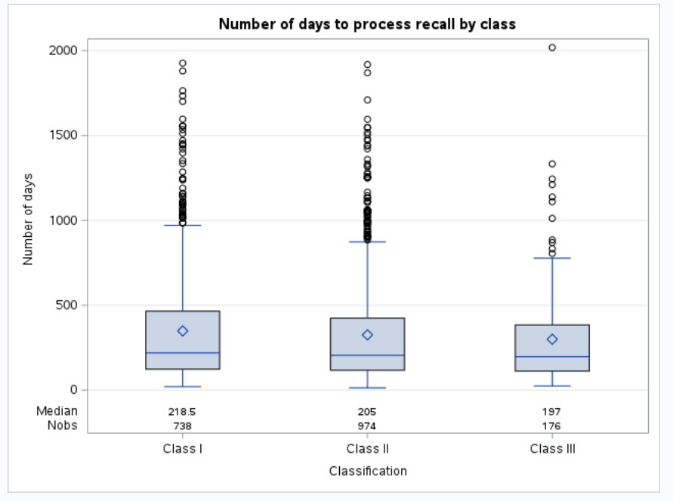
Days to process recall by classification

